Slide 1

Meet the…
Awoo Corporation
Engineering Department
Where crazy ideas come to life! …sometimes

Slide 2

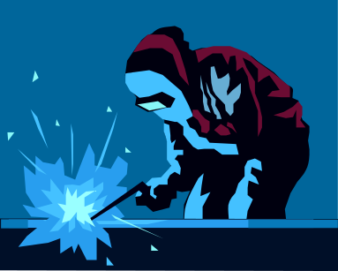


Awoo Corporation
Engineering Department
Meet the Experts
Bytey Wolf
Sharpyclaws Alpha
Mike Fierce
Sillypaws Fluffy

Slide 3
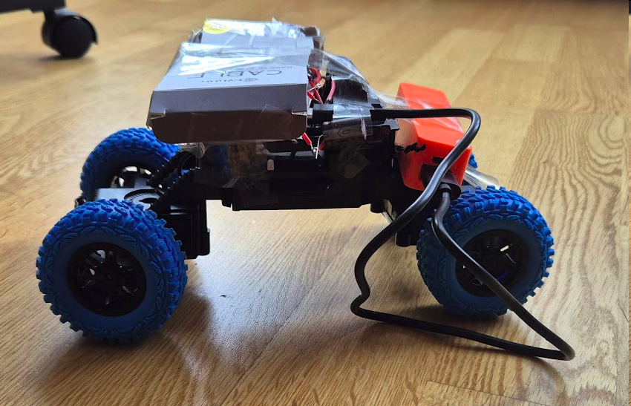
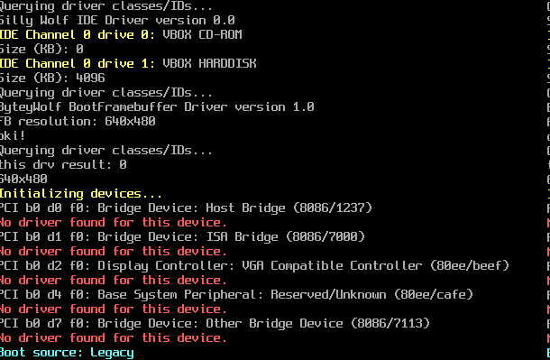

Awoo Corporation
Engineering Department
Our Developments
The Carigy
(autonomous Internet vehicle)
WolfOS
(custom x86 OS)
GrrGif
(in-house GIF editor)
And this is just in October…

Slide 4

Awoo Corporation
Engineering Department
Our Rules
Collaborate, not hate
Respect everyone and help them achieve their goals
Be resourceful and not wasteful
Function over form
Awoooooooooooooooo

Slide 5

Awoo Corporation
Engineering Department
Our Spendings
We only spent 28% of our budget, while earning back way more!
We are doing WONDERFULLY economically!!
Employee Name | Item | Quantity | Cost-1 | Cost-Total
Bytey Wolf | ESP32 Microcontroller | 1 | 225,00 грн. | 225,00 грн.
Bytey Wolf | 880uf Capacitor | 5 | 8,00 грн. | 40,00 грн.
Bytey Wolf | LGA775 Motherboard | 1 | 200,00 грн. | 200,00 грн.
Bytey Wolf | 1GB PC2-RAM | 1 | 0,00 грн. | 0,00 грн.
Fluffy Sillypaws | 100pcs Resistor Set | 1 | 250,00 грн. | 250,00 грн.
Fluffy Sillypaws | Masking Tape 1m | 10 | 15,00 грн. | 150,00 грн.
Fluffy Sillypaws | Copper Wire 1m | 50 | 7,00 грн. | 350,00 грн.
Fluffy Sillypaws | CFT-456 Microchip | 2 | 156,00 грн. | 312,00 грн.
Sharpyclaws Alpha | SIM800L GSM Module | 2 | 250,00 грн. | 500,00 грн.
Sharpyclaws Alpha | The Prodigy CD | 1 | 300,00 грн. | 300,00 грн.
Sharpyclaws Alpha | SyncMaster 940n Monitor | 1 | 50,00 грн. | 50,00 грн.
TOTAL |  |  | 1 461,00 грн. | 2 377,00 грн.

Slide 6
Awoo Corporation
Engineering Department
THANKS

